Slide 1
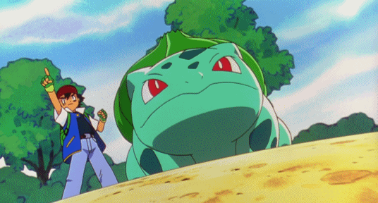
Unit 2: What can you do?
I can use vine whip!

Slide 2
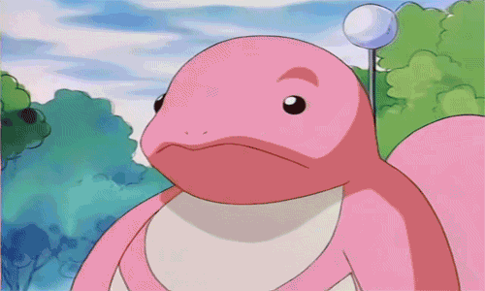
Let’s be Lickitung to read aloud!
I can …?

Slide 3
fly
cook

Slide 4
jump
draw

Slide 5
swim
read

Slide 6
sing
write

Slide 7
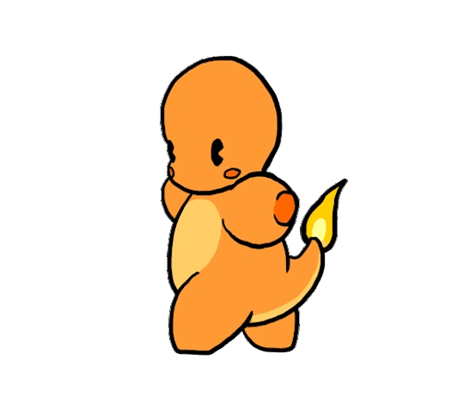
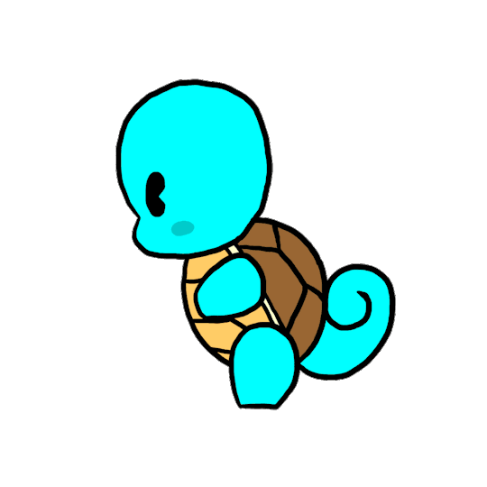
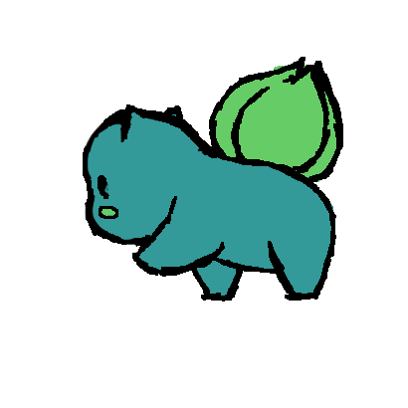
walk

Slide 8
swim
run

Slide 9
What can Harry Potter do?
He can write.

Slide 10
What can you do?
I can draw.

Slide 11
What can she do?
She can read.

Slide 12
What can he do?
He can cook.

Slide 13
What can it do?
It can walk.

Slide 14
What can they do?
They can run.

Slide 15
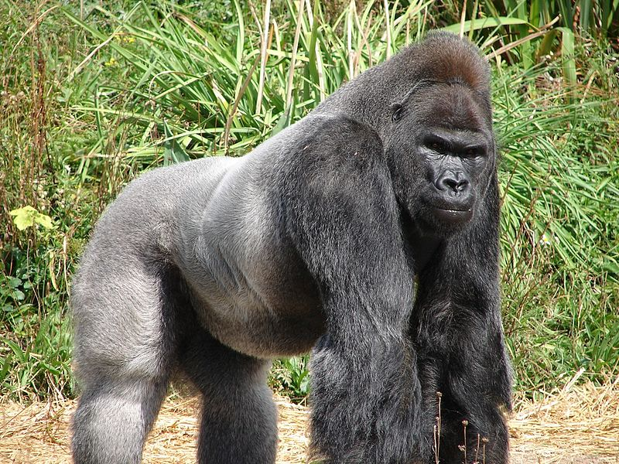
From Head to Toe By Eric Carle

Slide 16
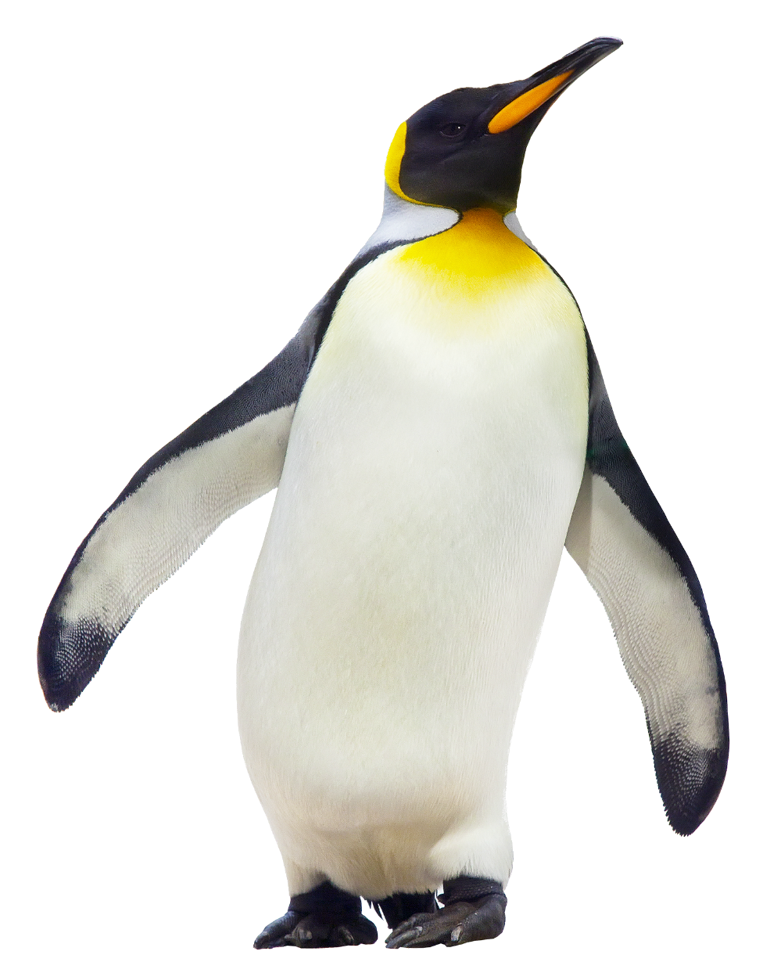
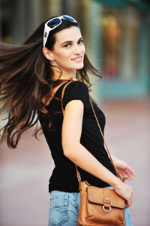
I am a penguin.
And I can turn my head.
Can you do it?
I can do it!

Slide 17
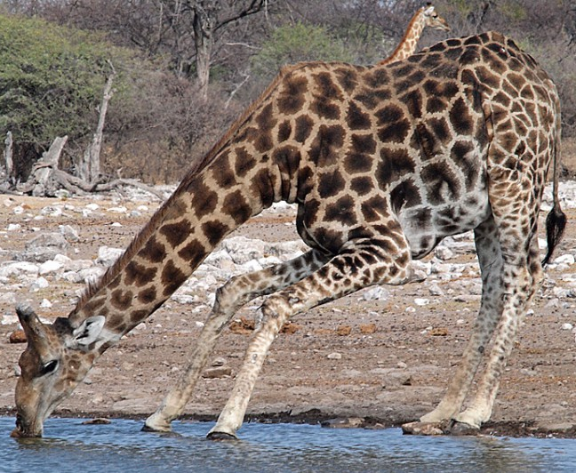
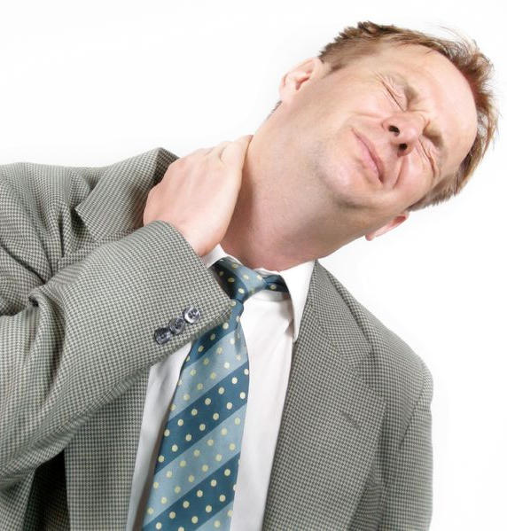
I am a giraffe.
And I can bend my neck.
Can you do it?
I can do it!

Slide 18
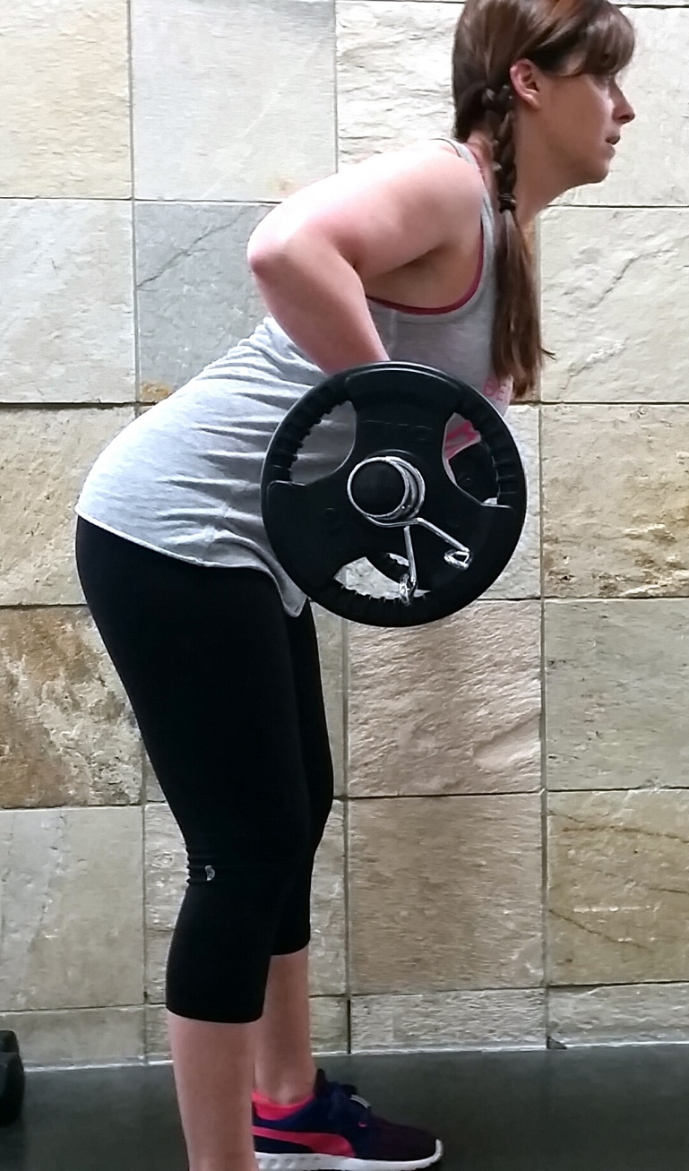
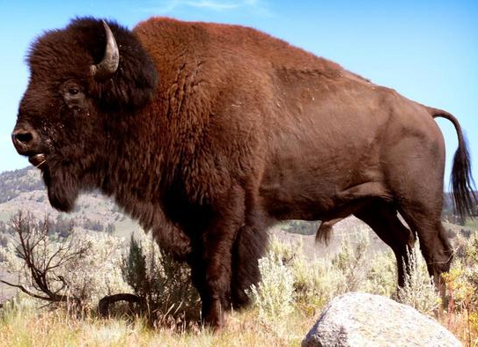
I am a buffalo.
And I can raise my shoulders.
Can you do it?
I can do it!

Slide 19
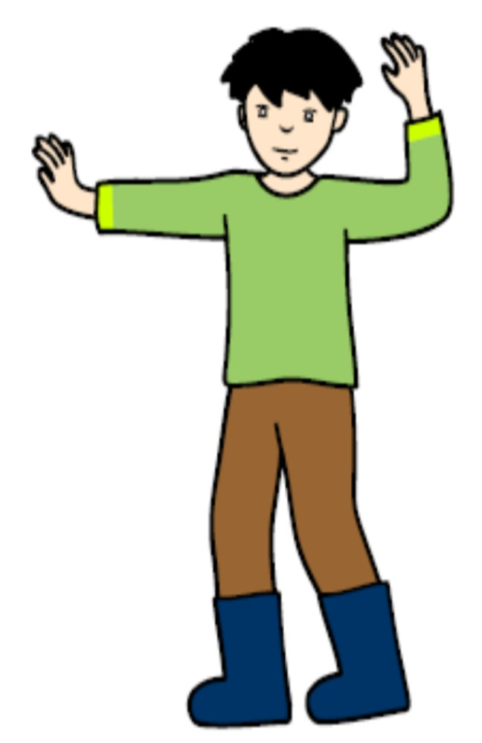
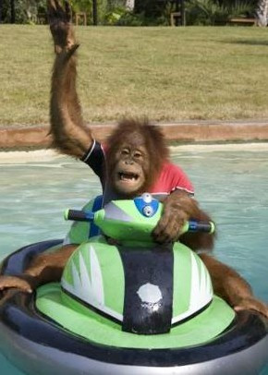
I am a monkey.
And I can wave my arms.
Can you do it?
I can do it!

Slide 20
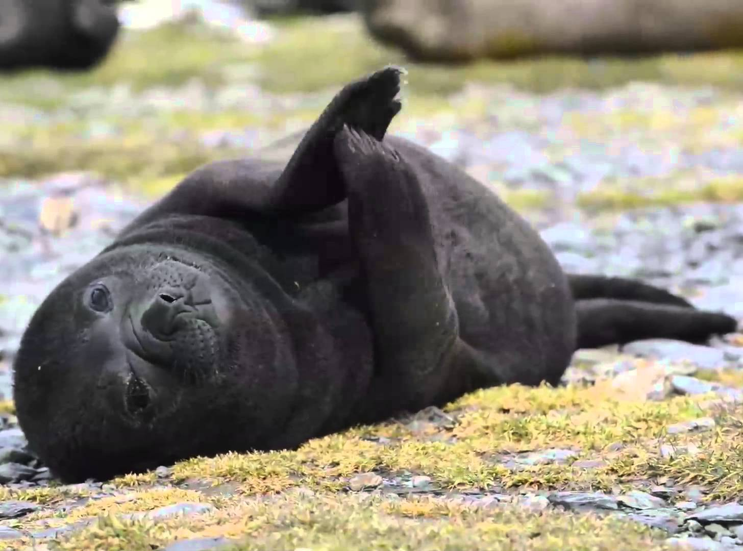
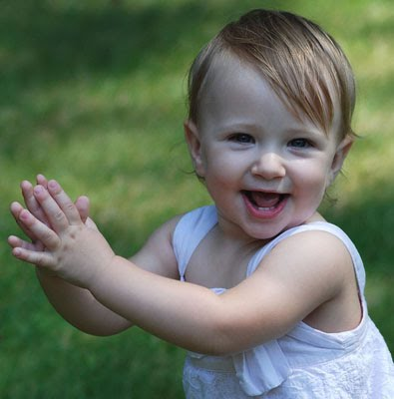
I am a seal.
And I can clap my hands.
Can you do it?
I can do it!

Slide 21
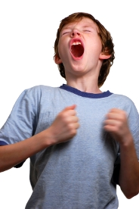
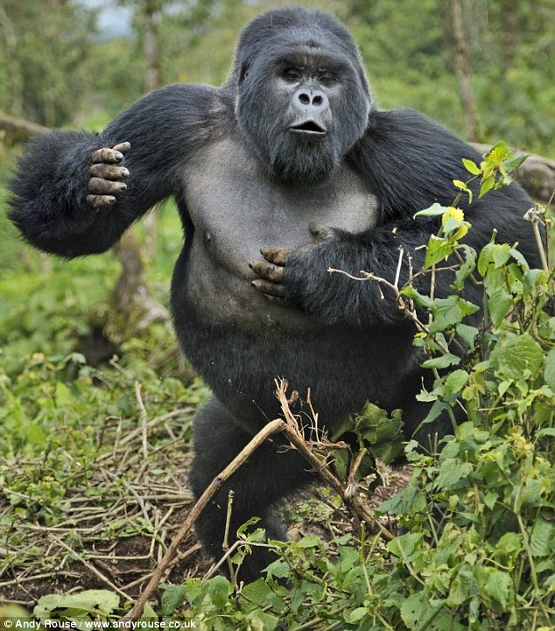
I am a gorilla.
And I can thump my chest.
Can you do it?
I can do it!

Slide 22
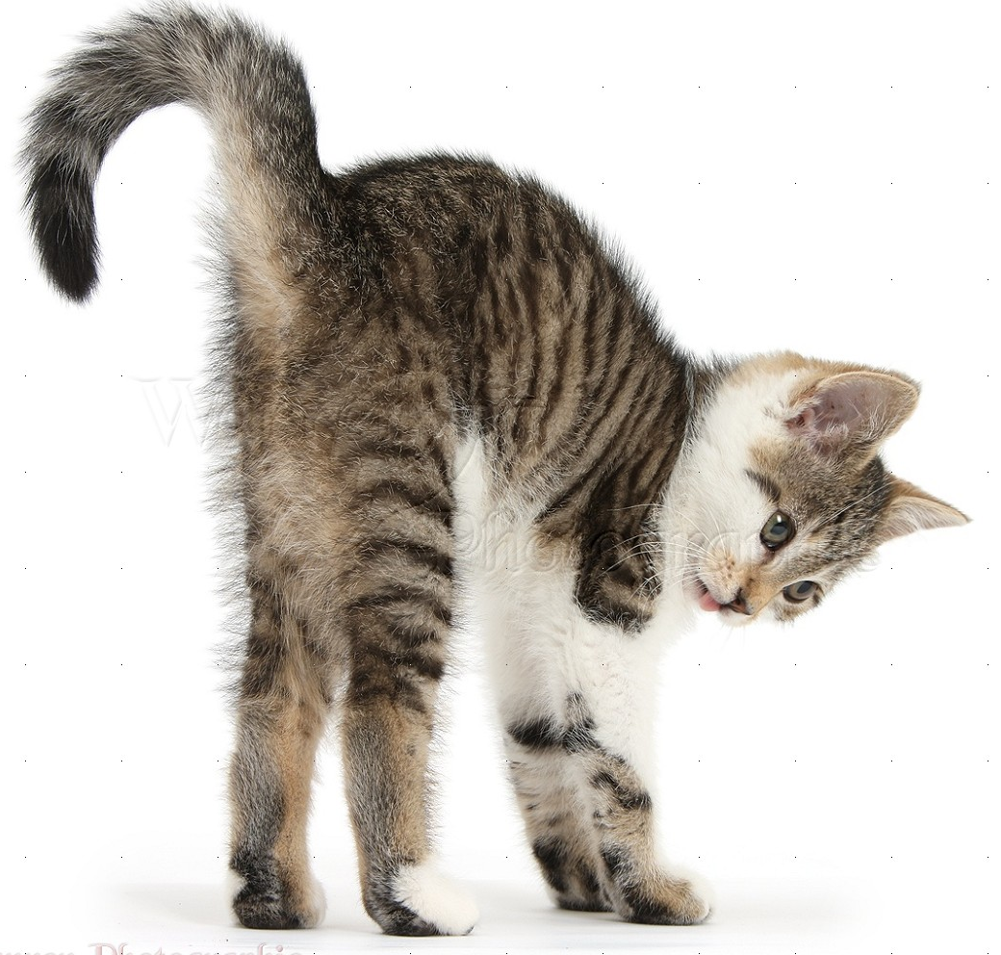
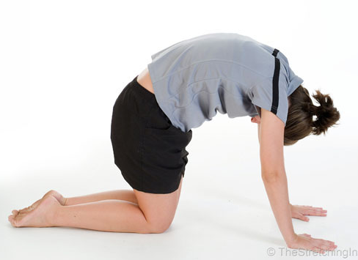
I am a cat.
And I can arch my back.
Can you do it?
I can do it!

Slide 23
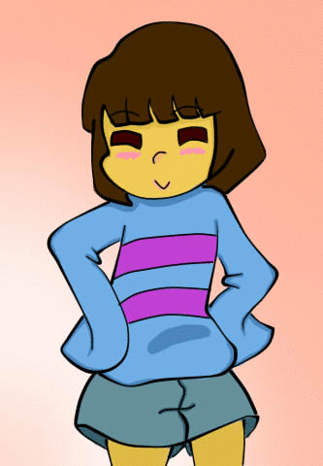
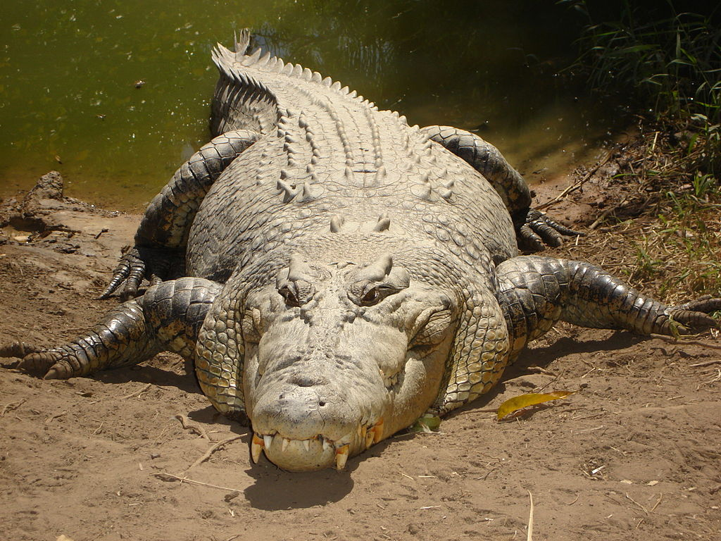
I am a crocodile.
And I can wriggle my hips.
Can you do it?
I can do it!

Slide 24
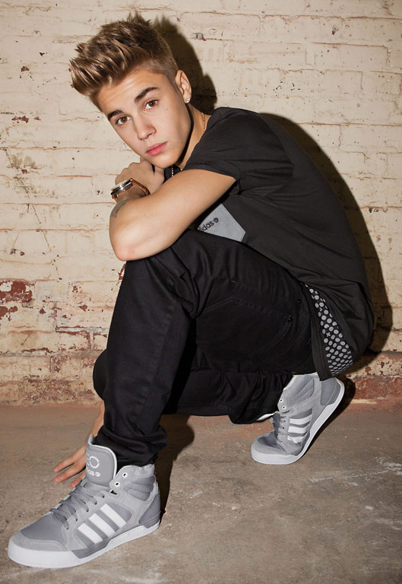
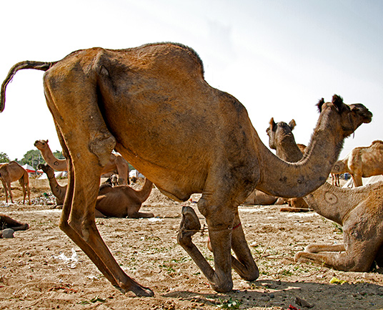
I am a camel.
And I can bend my knees.
Can you do it?
I can do it!

Slide 25
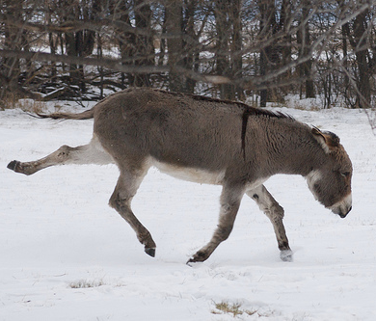
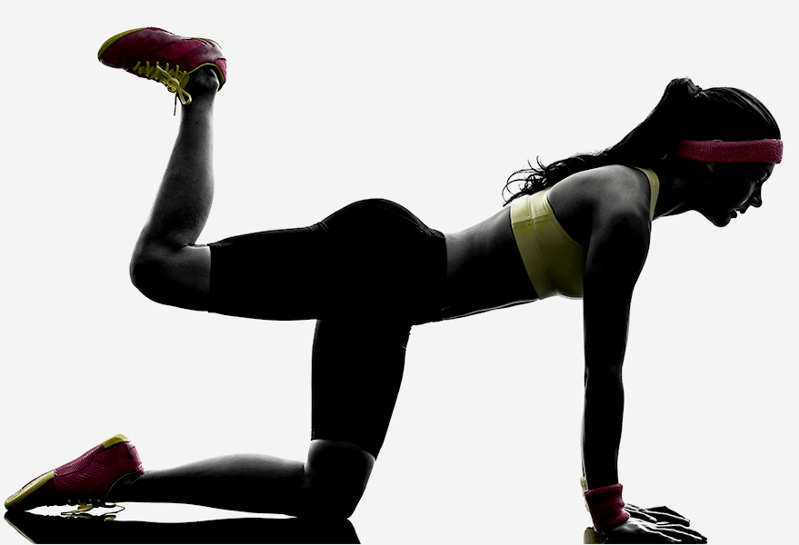
I am a donkey.
And I can kick my legs.
Can you do it?
I can do it!

Slide 26
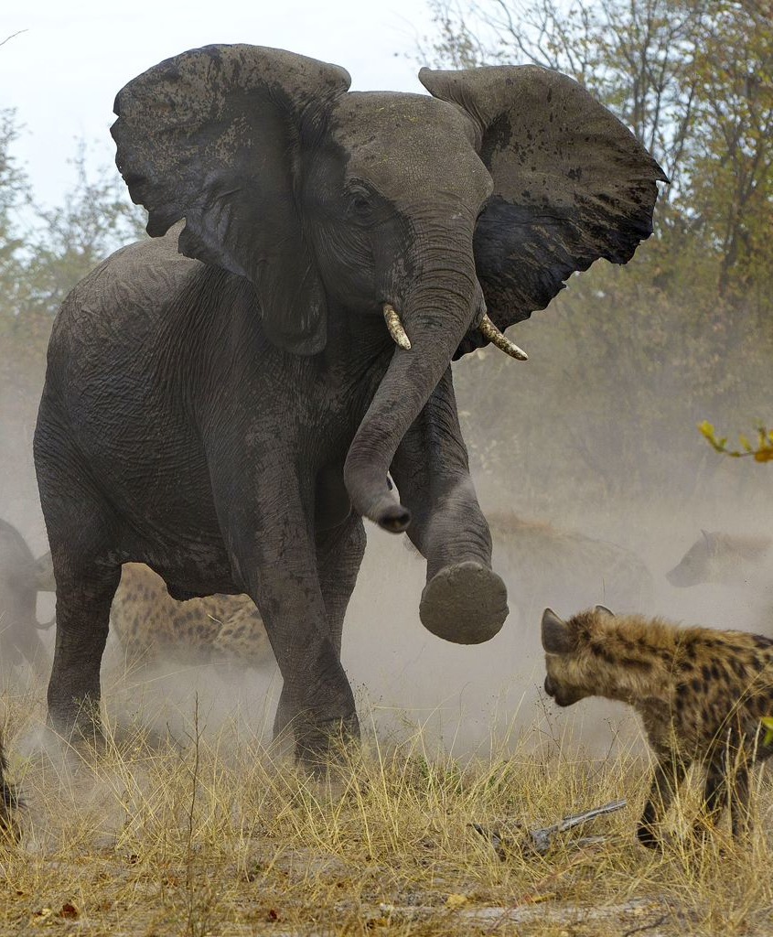
I am an elephant
And I can stomp my foot.
Can you do it?
I can do it!

Slide 27
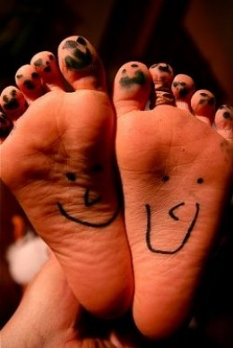
I am I
And I can wiggle my toes.
Can you do it?
I can do it!
I can do it!

Slide 28
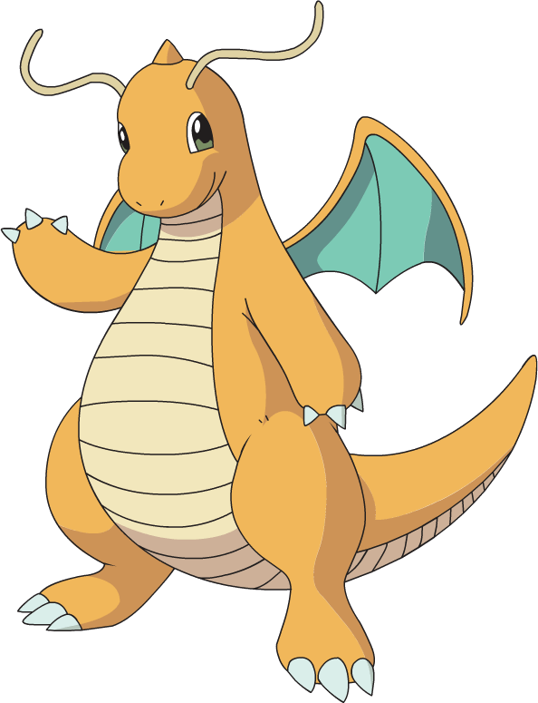
Let’s see your masterpiece!
From Head To Toe- By 304

Slide 29
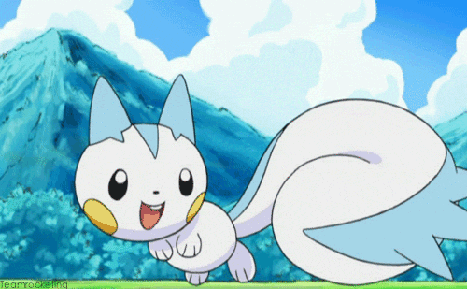
Good job!
Let’s turn to page 22 and listen to the story.

Slide 30
What can Danny do?
What can Irene do?
What can Dino do?
What can Danny’s puppet do?
What can Irene’s puppet do?
What can Owen’s horse do?
What happened in the end?

Slide 31
Danny can draw.
Irene can write.
Dino can read.
Danny’s puppet can walk.
Irene’s puppet can dance.
Owen’s horse can run.
They made a trouble.

Slide 33
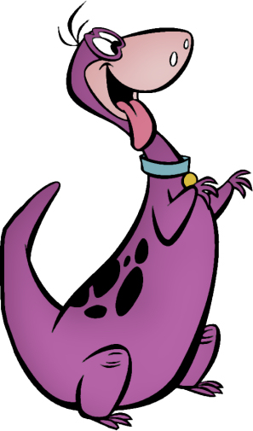
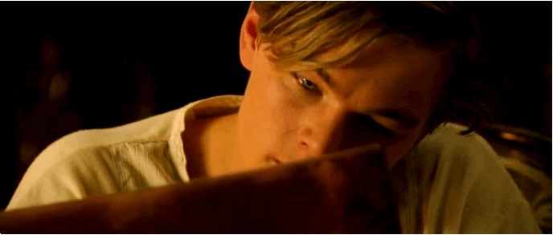
Wow! Danny, you can draw.
Yes, I can.

Slide 34
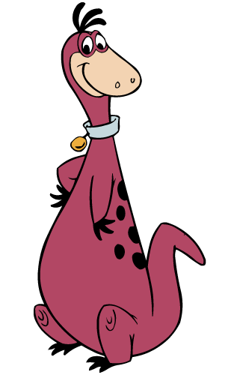
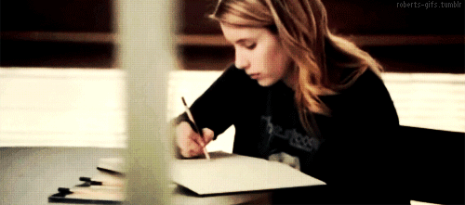
And you can write, Irene.
That’s right.

Slide 35
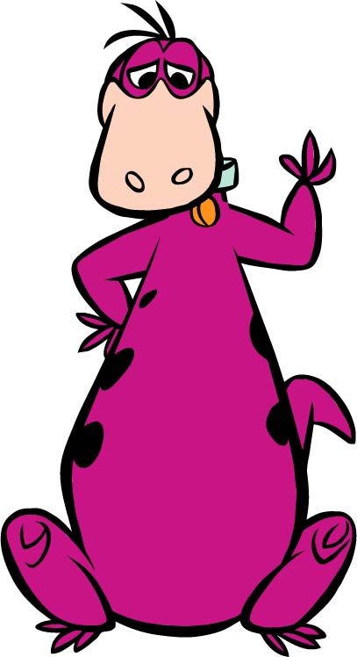
What can you do,Dino?
I can read.
Once upon a time…

Slide 36
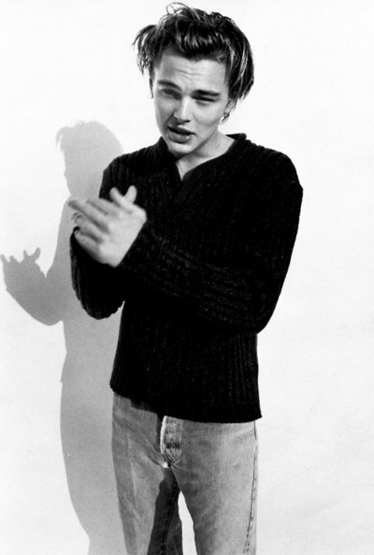
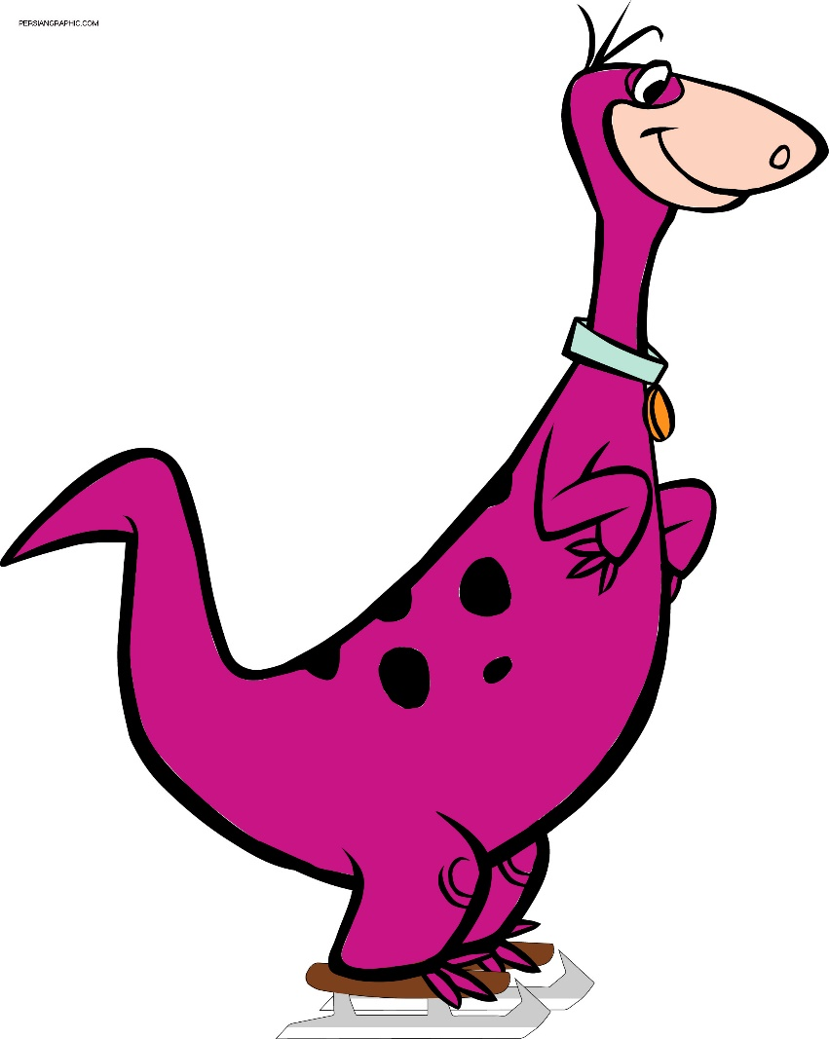
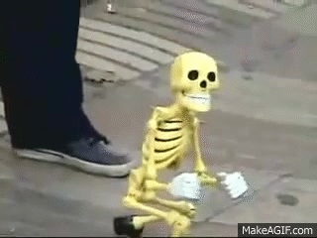
Look my puppet.
He can walk.

Slide 37
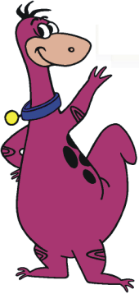
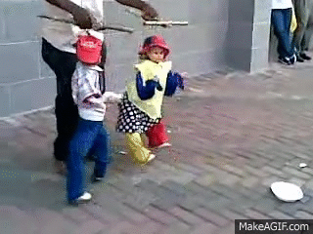
Look! She can dance.
Cool!

Slide 38
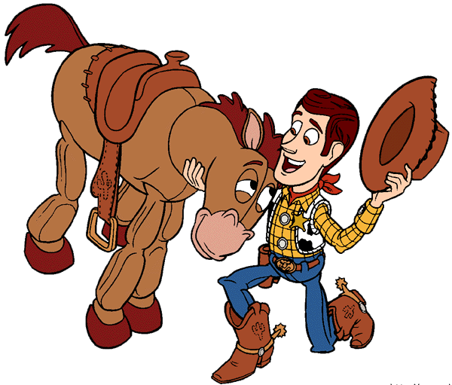
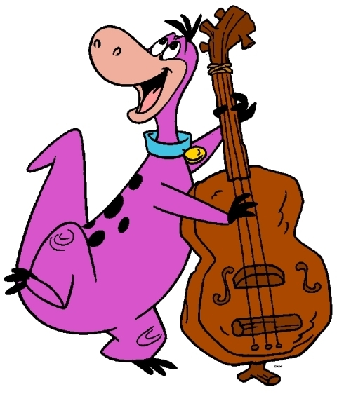
Look at my horse.
What can it do?
It can run.

Slide 39
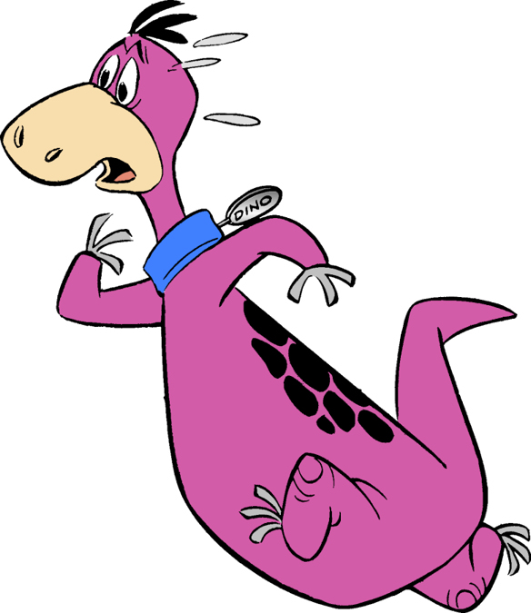
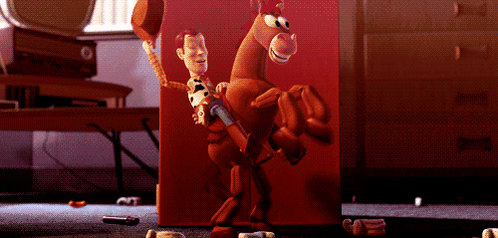
Oh, no!!!
Watch out!

Slide 40
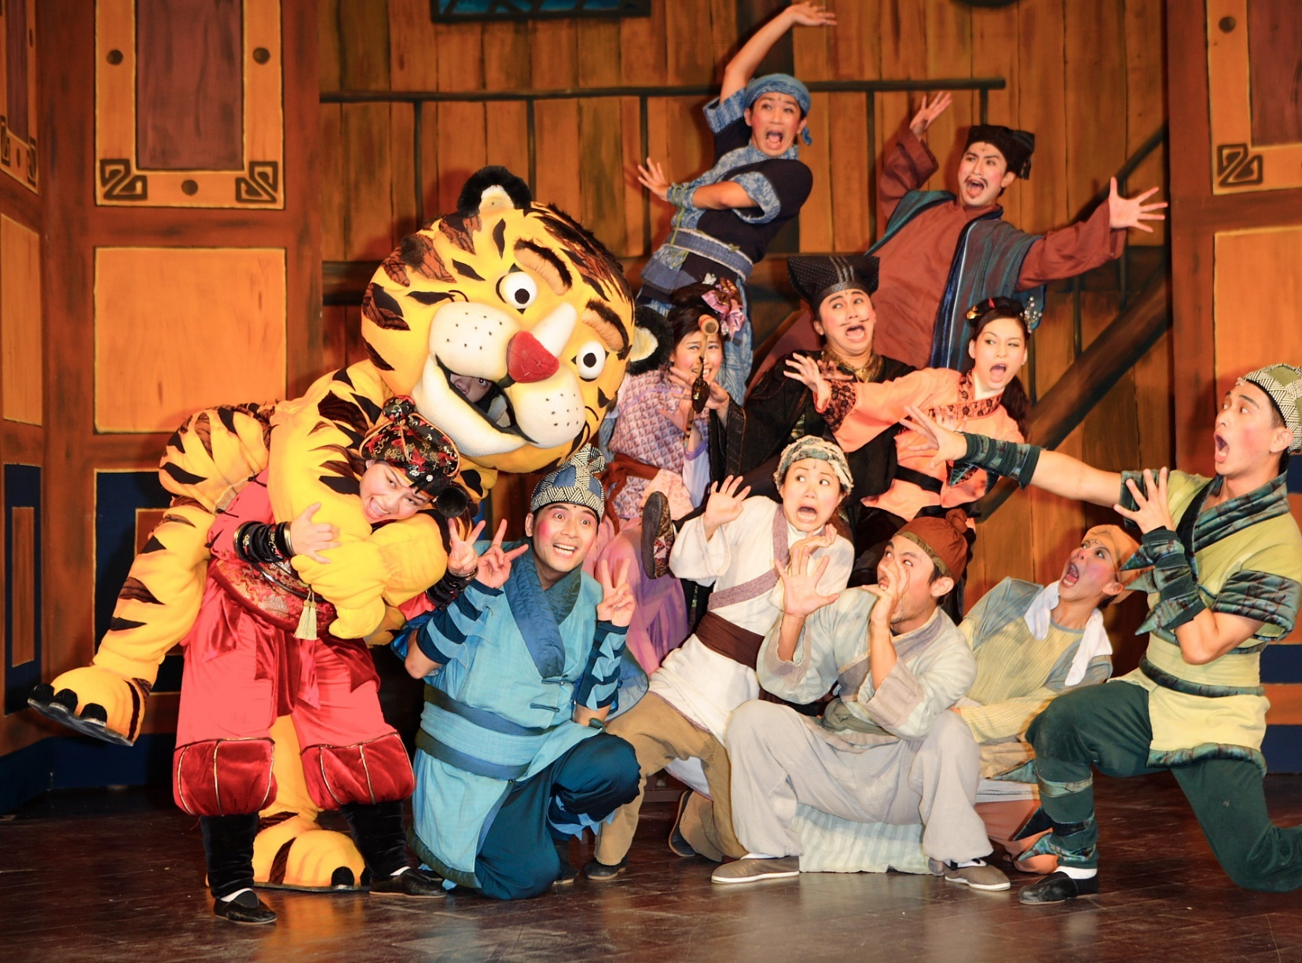
Play戲劇/表演

Slide 41
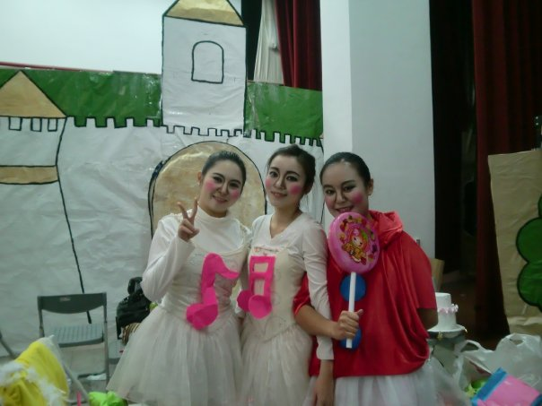
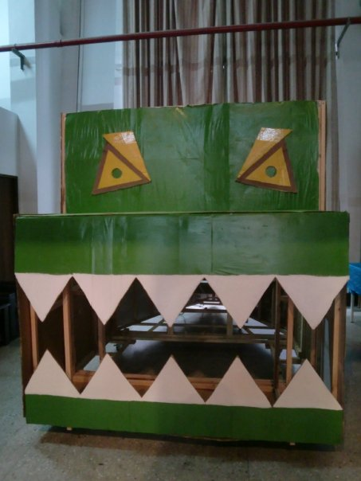
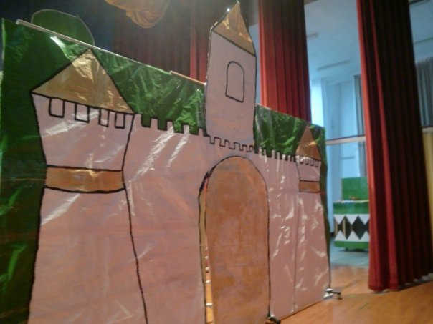
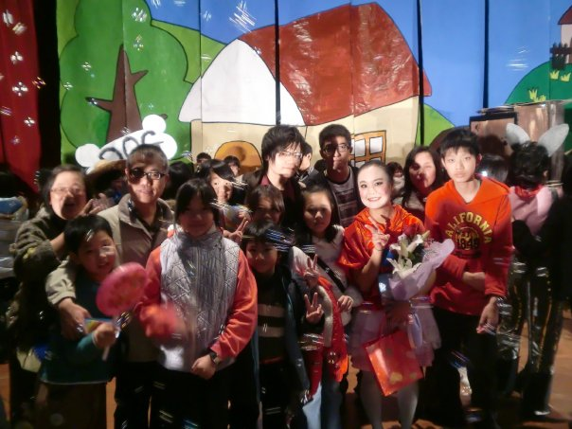
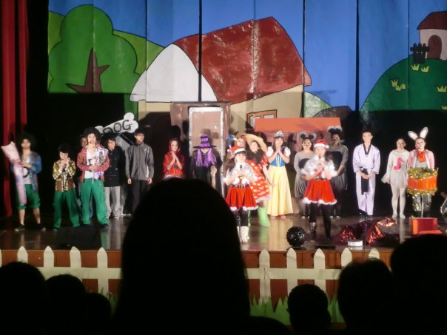

Slide 42
Snow White白雪公主

Slide 43
puppet木偶

Slide 44
Once upon a time…很久很久以前

Slide 45
watch out 小心/留意

Slide 46
Wow! Danny, you can draw.
Yes, I can.

Slide 47
And you can write, Irene.
That’s right.

Slide 48
What can you do,Dino?
I can read.
Once upon a time…

Slide 49
Look my puppet.
He can walk.

Slide 50
Look! She can dance.
Cool!

Slide 51
Look at my horse.
What can it do?
It can run.

Slide 52
Oh, no!!!
Watch out!

Slide 53
1 → Echo (last words for 3 times)
2 → Group 2/4 read
3 → Group 1/3/5 read
4 → Mandy reads (Find mistake)
5 → Free
6 →

Slide 54
Let’s sing “I can…”

Slide 55
I Can
I can fly,
I'm proud that I can fly
To give the best of mine
The heaven in the sky

Slide 56
Pumpkin Cartoon

